Slide 1

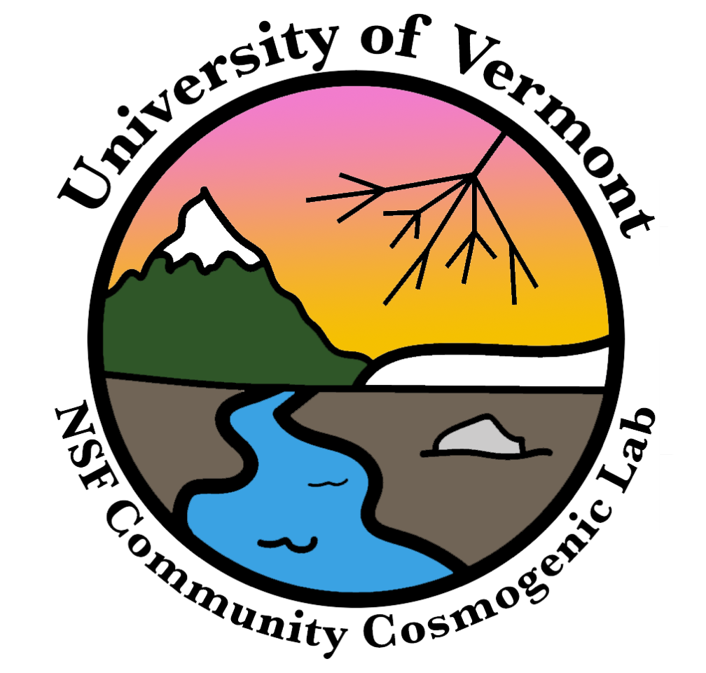
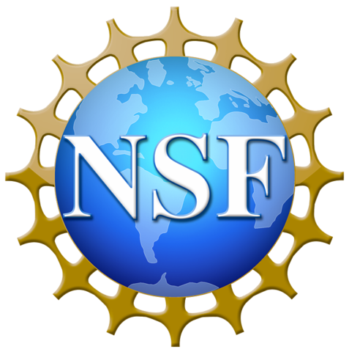

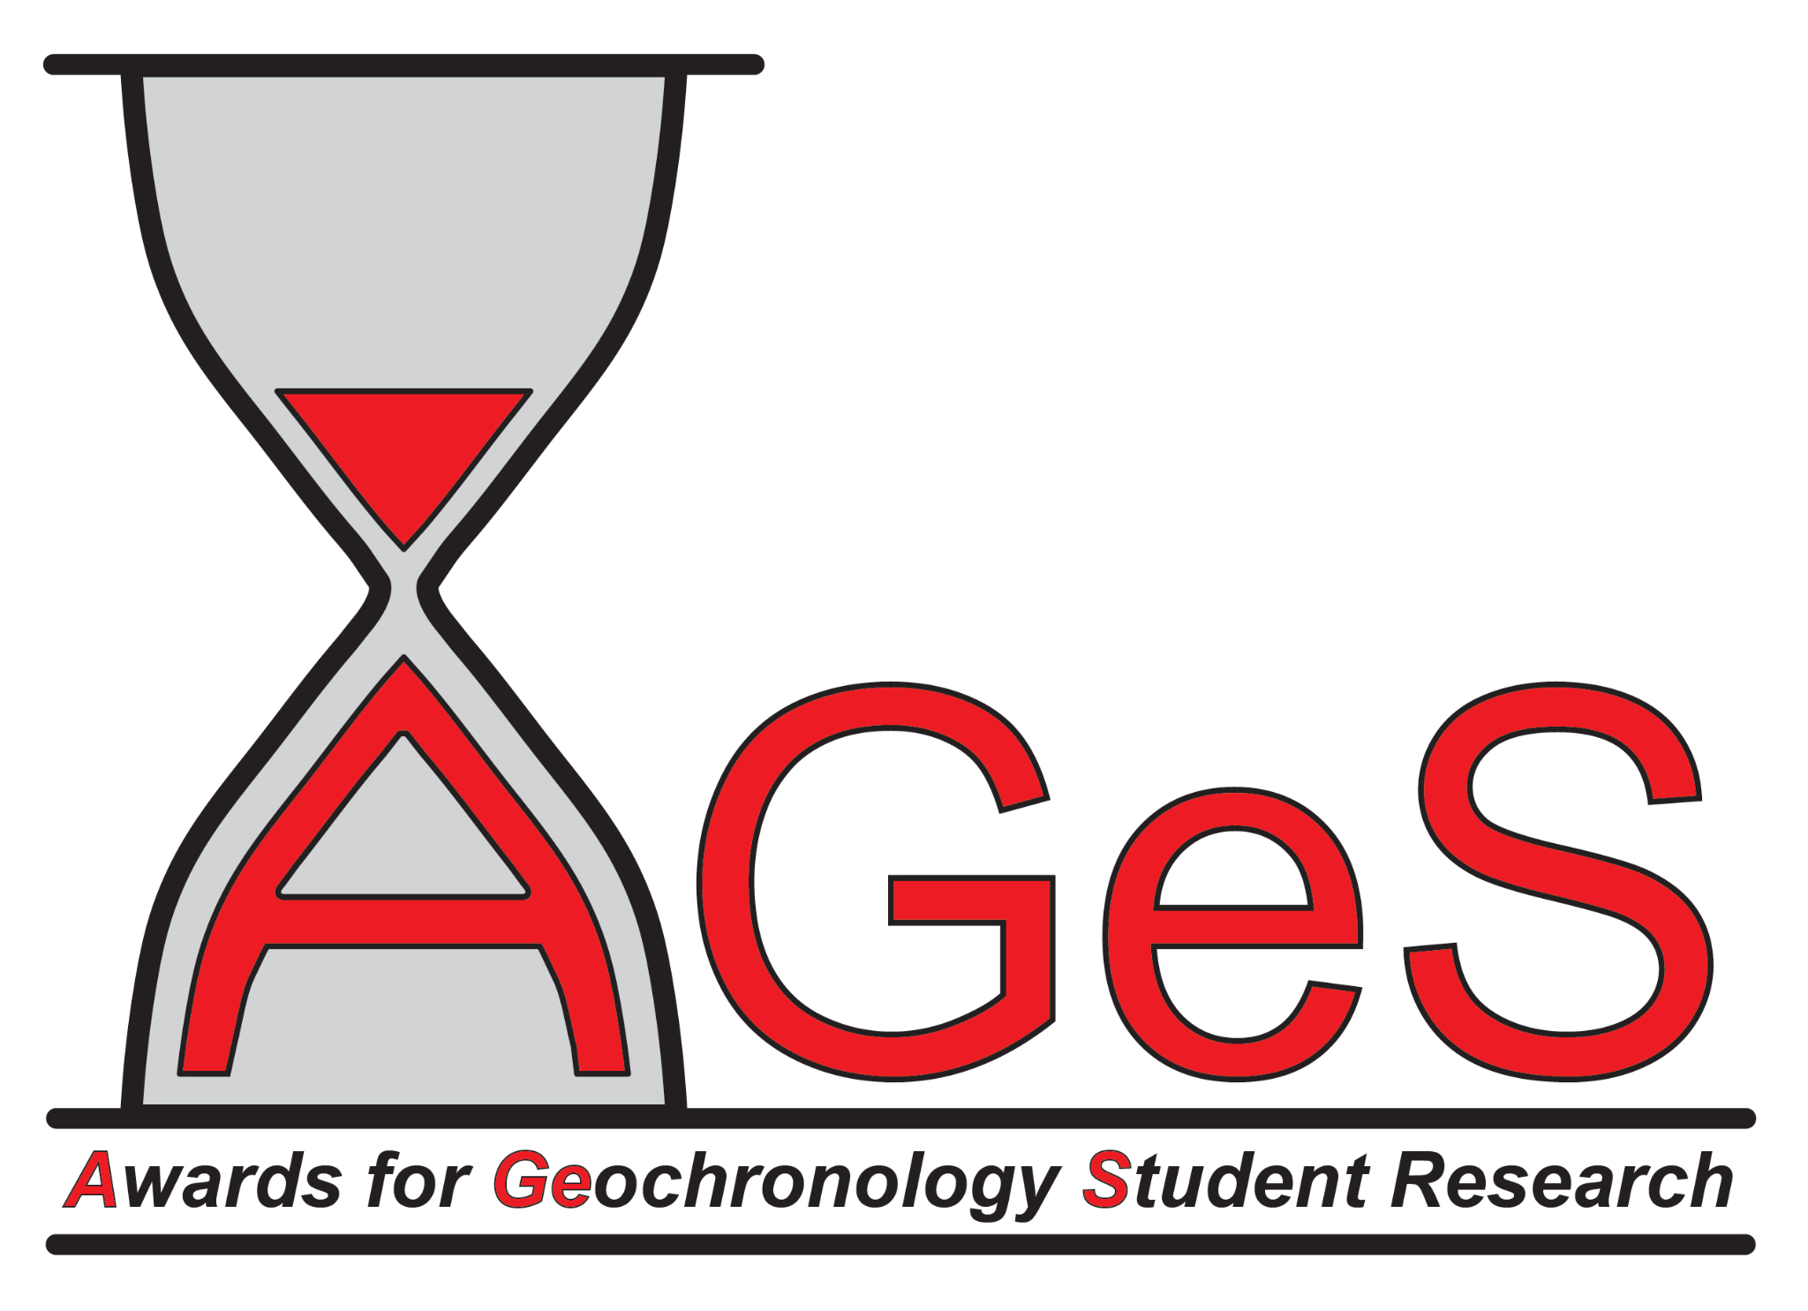
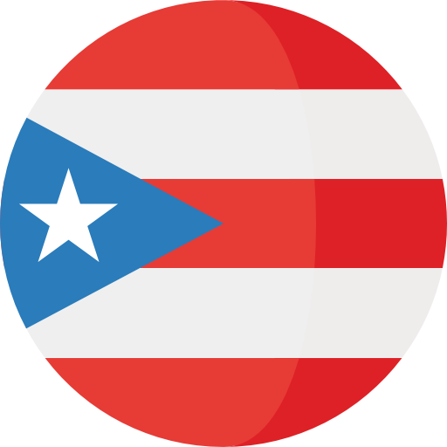


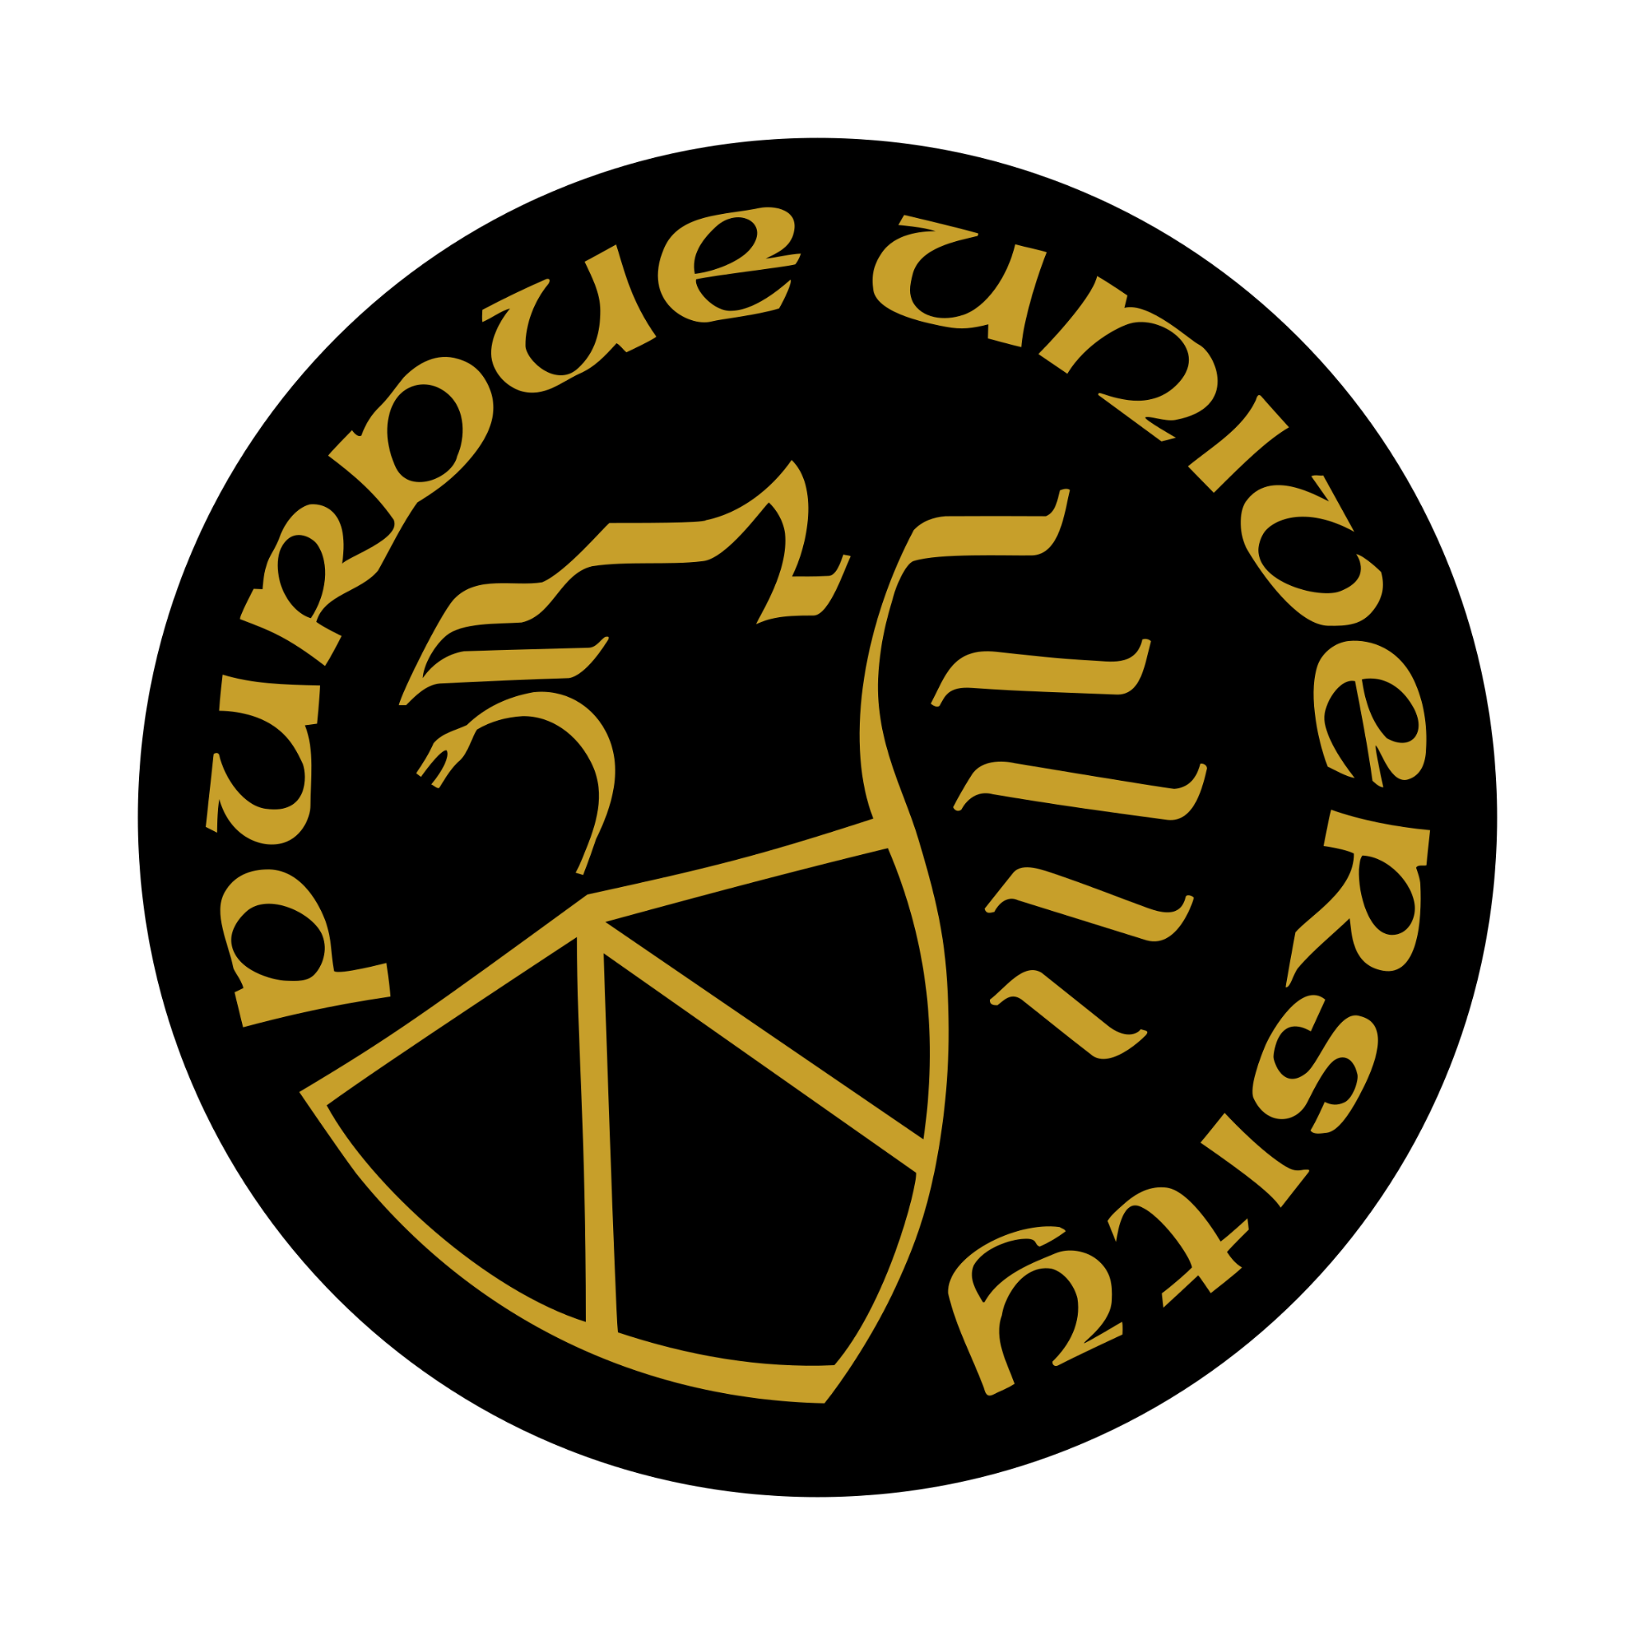
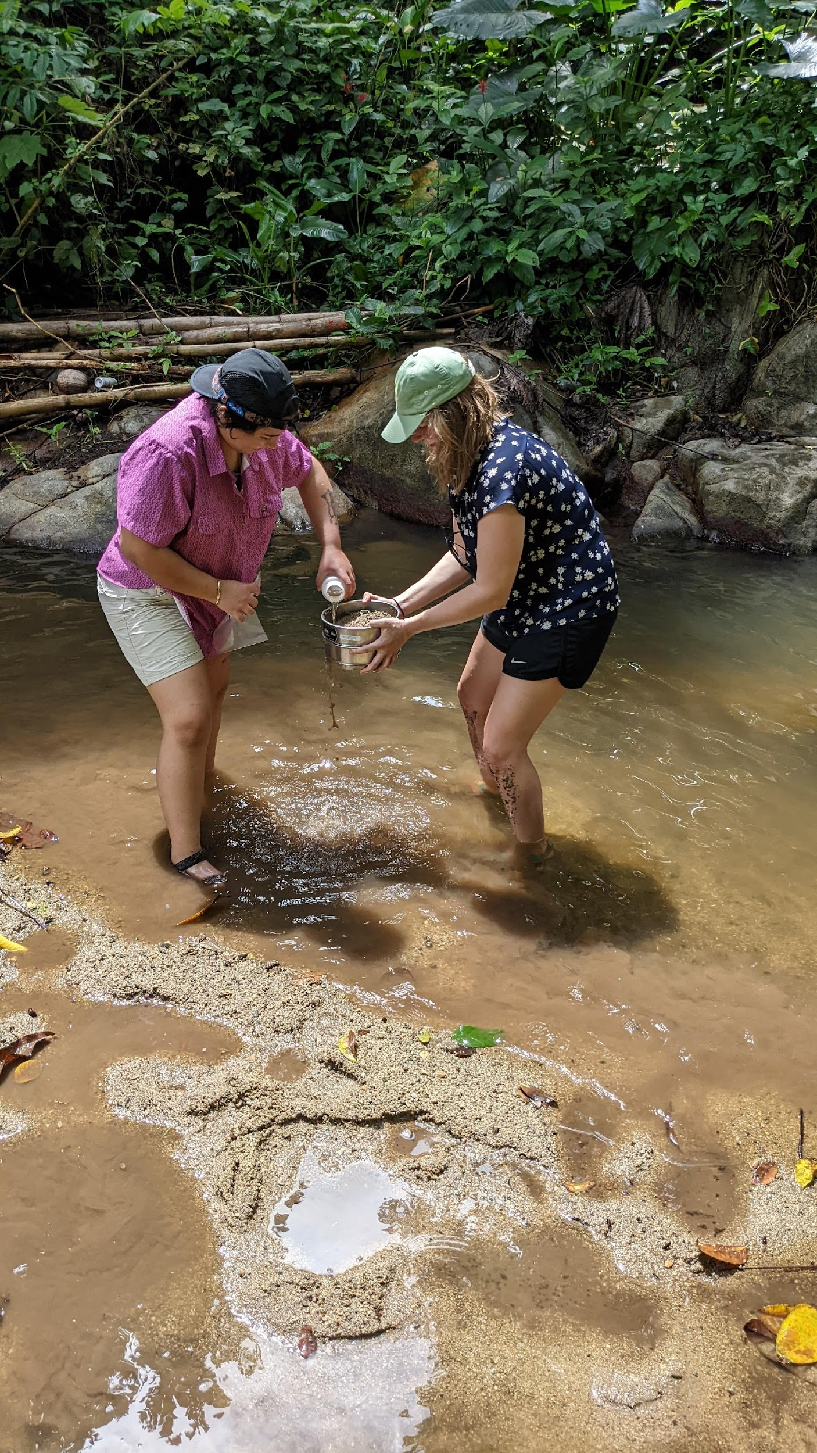
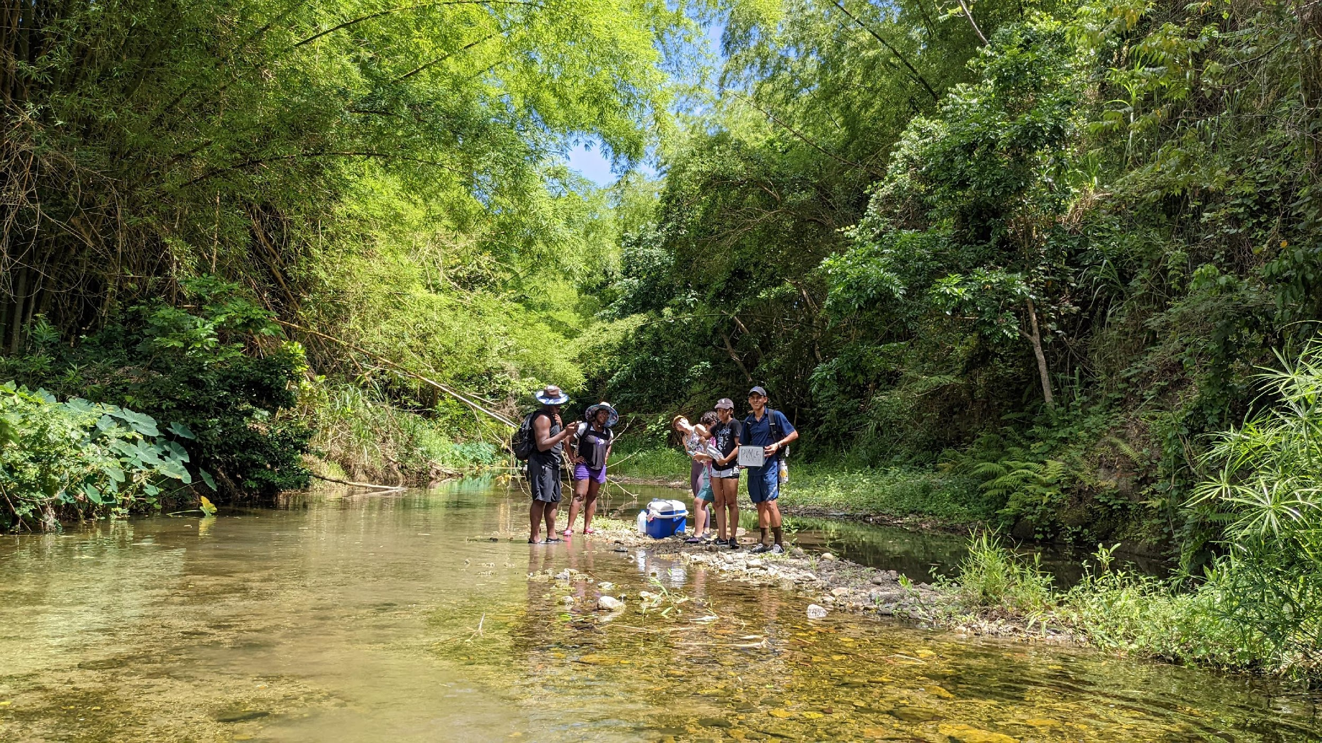
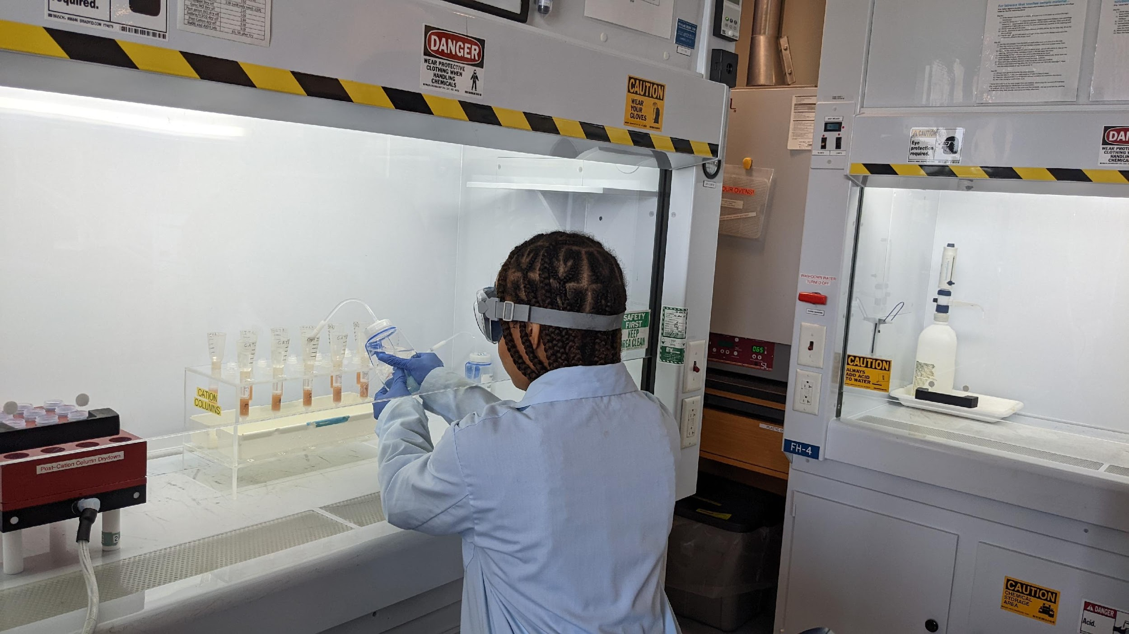
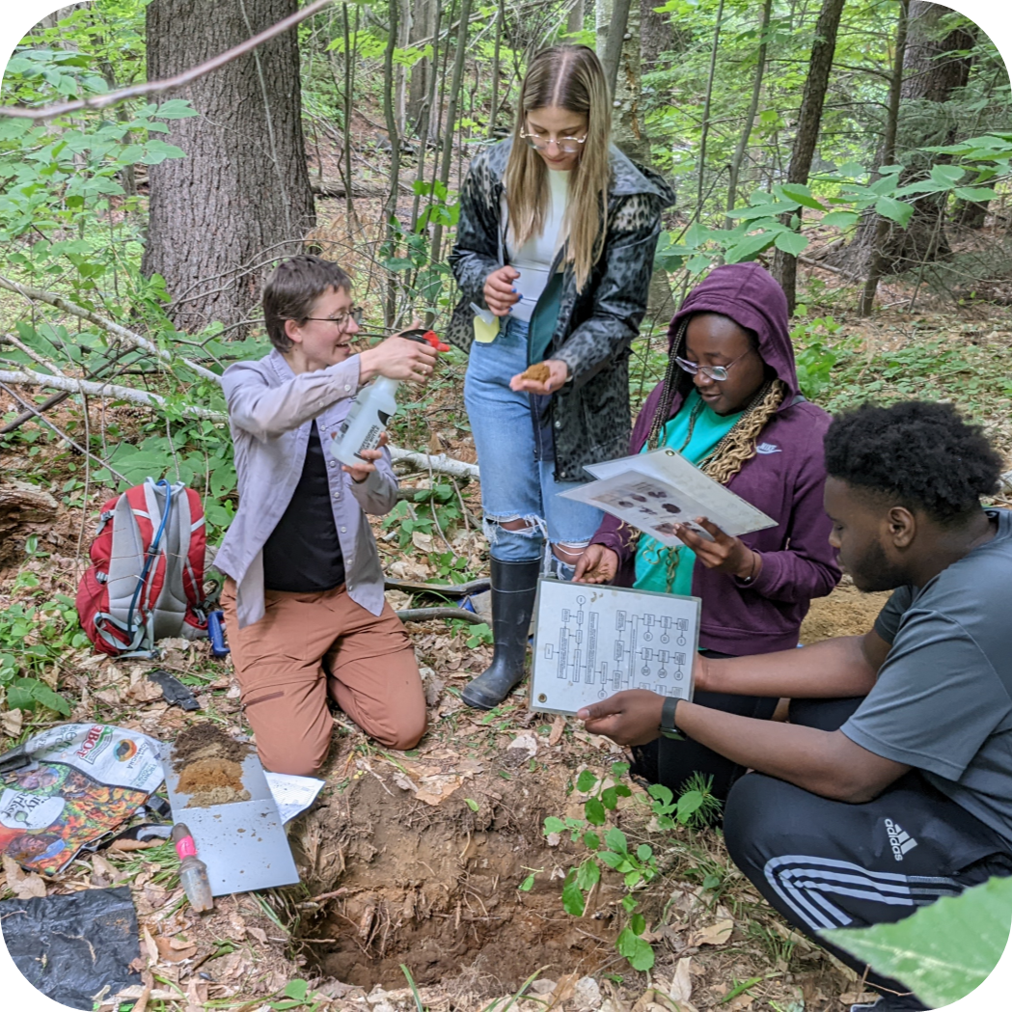
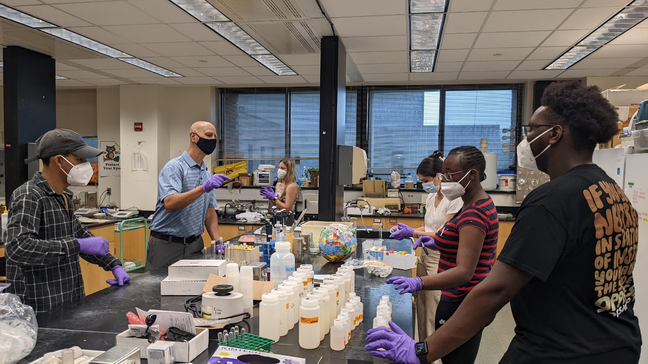
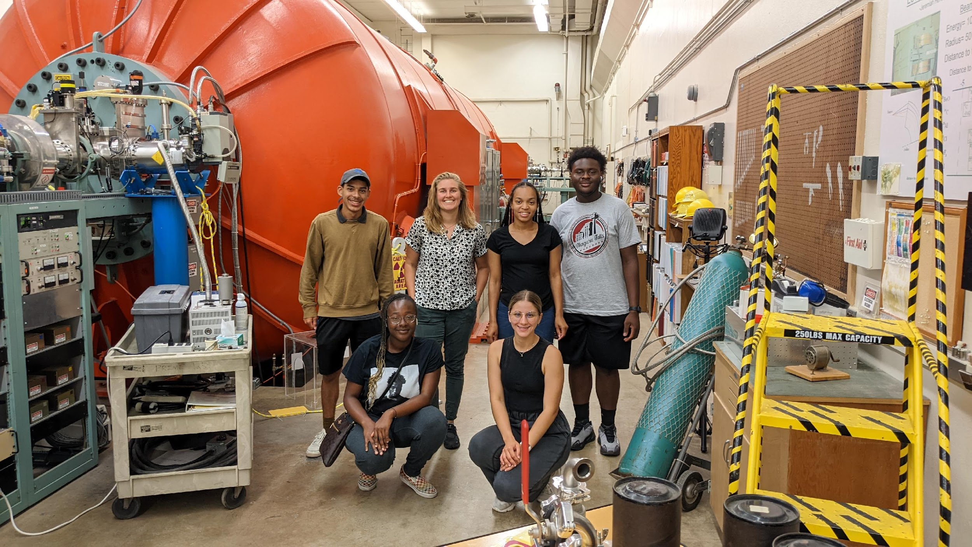
Inventing AUGR: reflections on designing and implementing an Authentic Undergraduate Geoscience Research experience
¹²BENNETT, Isabella B., ¹²Soto-Villanueva, Krizzia., ¹²Bierman, Paul R., ¹Corbett, Lee B., ³Acosta-Colon, Angel., ⁴Hughes, Stephen K., ⁵Whittaker, Joseph A.,
¹Natural Resources Department, University of Vermont, ²Gund Institute for Environment, ³University of Puerto Rico Arecibo, ⁴University of Puerto Rico Rio Piedras, ⁵Jackson State University, Jackson MS
Program Goals
Last winter, we created an undergraduate research experience that would:
Make interdisciplinary environmental science research accessible (regardless of previous exposure)
Provide valuable field and lab skills relevant across disciplines
Build students’ mentoring and professional networks
Model non-extractive field work practices
Help students’ formulate their confidence and identities as scientists and increase their sense of belonging in STEM
Introduction
We designed and ran an undergraduate summer research experience (AUGR) to train and engage students from Minority Serving Institutions in every stage of environmental research. We brought together a cohort of 3 students from Jackson State University (Jackson, MS) and 2 students from the University of Puerto Rico system. Through the lenses of geomorphology, water geochemistry, geochronology, and environmental science, we used the following questions as guideposts as we trained students in field, lab, and data analysis methods.
1. How fast are Puerto Rican landscapes changing? How does such change affect people, farms, and food sustainability?
2. What are the effects of current and past land use on the Puerto Rican landscape? Is this use sustainable?
Program Outcomes
Throughout this program, our inaugural group of AUGR students gained:
Field sampling competency & confidence
Experience conducting high precision lab procedures & using lab instruments
New connections within professional, mentoring, and personal networks
Hands-on experience in research practices beyond their chosen majors
Experience presenting at a national science meeting (please go visit our students posters!)
Site recon & pre-sampling
March 2022
Formed connections with property owners
Collected preliminary field data, stream water & sediment samples
Student field training
June 3-10, 2022
1 week of field training in southeastern Puerto Rico
Collected samples from 18 field sites within two adjacent watersheds
Clean lab work at UVM
June 11-24, 2022
Extracted in-situ 10Be from 10 stream sediment samples over 5 days
Explored mineral separation for in-situ cosmogenic nuclide analysis
Interdisciplinary exploration
June 11-24, 2022
learned to: identify soil horizons, use an XRF, XRD, ICP-OES, C-analyzer & fly a drone
Learned about: pollinators, science communication and policy & more
Water chemistry @ Williams
June 26, 2022
Measured major cations and anions, made standards & performed titrations
learned AA, colorimetry, and anion chromatography instrumentation
AMS at Purdue PRIME lab
July 1, 2022
Quantified Be-10/Be-9 ratio
Calculated erosion rates using CRONUS calculator
In 5 days, we scouted 50+ potential field sites for accessibility and scientific relevance.
Once our research plan & funding were confirmed, we recruited students from a wide range of departments at JSU and UPR, ultimately selecting a cohort of 5 students.
We trained students to measure stream dimensions, conductivity, pH, collect sediment and water samples, test for E. Coli, make scientific observations, record field notes & take field photos.
We visited El Yunque to learn about ongoing research projects in Puerto Rico at TRACE and the LTER.
Through the 10Be extraction procedure, students learned to pipette, extract sample aliquots, conduct pH titrations & perform column chemistry to remove unwanted elements and isolate desired elements. They saw their sediment samples reduced to tiny beads of BeOH and packed into cathodes for AMS analysis.
While in Burlington, students met with 22+ members of the UVM and greater VT community to gain new skills and a sense of how place based science is conducted and serves VT directly.
This stage of the program was designed to help students build professional connections and highlight interdisciplinary science.
AUGR students learned to perform water chemistry analysis techniques and the applications of this research from several Williams faculty undergraduate students.
Students leared about ongoing sustainability projects and initiatives at Williams College.
At PRIME, students learned about how the Accelerator Mass Spectrometer (AMS) identifies distinct atoms, calculated the number of atoms per grams of each of our samples in real time and then translated these into erosion rates. Some students also went to meet potential graduate advisors on campus while the AMS chugged along.
Acknowledgments
This program was funded by: The Gund Institute for Environment, AGeS-DiG, & NSF-EAR 1735676, Laboratory Technician Support: National sample preparation facility for broadening participation, research, and hands-on research training in cosmogenic nuclide studies.
This program would not have been possible without the support and guidance of our academic collaborators Amanda Schmidt, Jay Racela, David Dethier, & Marc Caffee; the generosity of our local landowners and collaborators Papo and the Amigos Del Rio community, Luz Delia Solis Fonseca, & Angel Ortiz Ramos; and the hands-on learning experiences provided by Iana Grullón-Penkova & the TRACE team, Jess Zimmerman, Jenny Bower, Julia Perdrial, Veronica Sosa Gonzalez, Nico Perdrial, Victoria Treto, Drew Christ, Taylor Ricketts, Basil Waugh, Stephen Posner, Tricia Coates, David Zuckerman & the UVM Spatial Analysis Lab Team.
Reflections for Program Improvement
Reflecting on our first summer, we believe the following changes that could improve further offerings
Incorporating mentors from each student’s home university to build ongoing connections & further the following:
Increasing scaffolding of research methods, relevance, and implications leading up to and throughout the program so that students face fewer obstacles reducing and interpreting data and preparing presentation materials
Adding more lessons to help students build data analysis and interpretation skills while at UVM so that they are properly prepared for individual work on data arriving after the summer portion of the program ends
Prioritizing the preparation of meeting abstracts and first poster drafts while at UVM to reduce student time commitment and stress at the beginning of the fall semester.
Guiding texts in program design
Berhe, A. A., Barnes, R. T., Hastings, M. G., Mattheis, A., Schneider, B., Williams, B. M., & Marín-Spiotta, E. (2022). Scientists from historically excluded groups face a hostile obstacle course. Nature Geoscience, 15(1), 2–4. https://doi.org/10.1038/s41561-021-00868-0
Chaudhary, V. B., & Berhe, A. A. (2020). Ten simple rules for building an antiracist lab. PLOS Computational Biology, 16(10), e1008210. https://doi.org/10.1371/journal.pcbi.1008210
Huntoon, J. E., & Lane, M. J. (2007). Diversity in the Geosciences and Successful Strategies for Increasing Diversity. Journal of Geoscience Education, 55(6), 447–457. https://doi.org/10.5408/1089-9995-55.6.447
Sharik, T. L. (2015). Diversifying Student Demographics in Forestry and Related Natural Resources Disciplines. Journal of Forestry, 113(6), 579–580. https://doi.org/10.5849/jof.15-031
Wolfe, B. A., & Riggs, E. M. (2017). Macrosystem Analysis of Programs and Strategies to Increase Underrepresented Populations in the Geosciences. Journal of Geoscience Education, 65(4), 577–593. https://doi.org/10.5408/17-256.1
Johnson‐Bailey *, J., & Cervero, R. M. (2004). Mentoring in black and white: the intricacies of cross‐cultural mentoring. Mentoring & Tutoring: Partnership in Learning, 12(1), 7–21. https://doi.org/10.1080/1361126042000183075
Anadu, J., Ali, H., & Jackson, C. (2020). Ten Steps to Protect BIPOC Scholars in the Field. Eos, 101. https://doi.org/10.1029/2020EO150525
Posselt, J., Miller, C. W. (2019). Rubric Design & Use. California Consortium for Inclusive Doctoral Education. https://urgeoscience.org/wp-content/uploads/sites/33/2021/03/Rubrics-Module.pdf (accessed Jan 2022).
Bierman, P., Hernández, R. Y. S., Schmidt, A. H., Aguila, H. A. C., Alvarez, Y. B., Arruebarrena, A. G., Campbell, M. K., Dethier, D., Dix, M., Massey-Bierman, M., Moya, A. G., Perdrial, J., Racela, J., & Alonso-Hernández, C. (2020). ¡Cuba! River Water Chemistry Reveals Rapid Chemical Weathering, the Echo of Uplift, and the Promise of More Sustainable Agriculture. GSA Today, 30(3), 4–10. https://doi.org/10.1130/GSATG419A.1
Campbell, M. K., Bierman, P. R., Schmidt, A. H., Sibello Hernández, R., Garcia-Moya, A., Corbett, L. B., Hidy, A., Cartas Águila, H., Guillén Arruebarrena, A., Balco, G., Dethier, D., & Caffee, M. (2021). Cosmogenic nuclide and solute flux data from central Cuba emphasize the importance of both physical and chemical denudation in highly weathered landscapes. Geochronology Discussions, 2021, 1–29. https://doi.org/10.5194/gchron-2021-31

